Slide 1
Dependency Trees and Shift-Reduce Parser
CS 162: Natural Language Processing
Nanyun (Violet) Peng
Course website: https://vnpeng.net/cs162_win23.html
syllabus,
announcements,
slides,
homeworks
1

Slide 2
Announcements
The course evaluation is up!
Please fill out the survey.
As we announced last Wednesday, if we get 80% turn out rate, everyone gets a +3% credit bump for the final exam. ☺
Current status: 29/128
Project final report is due next Monday, March 18, 11:59pm.

Slide 3
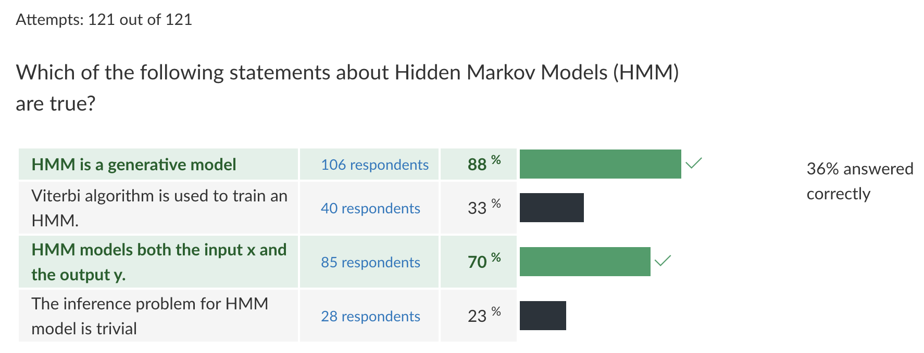
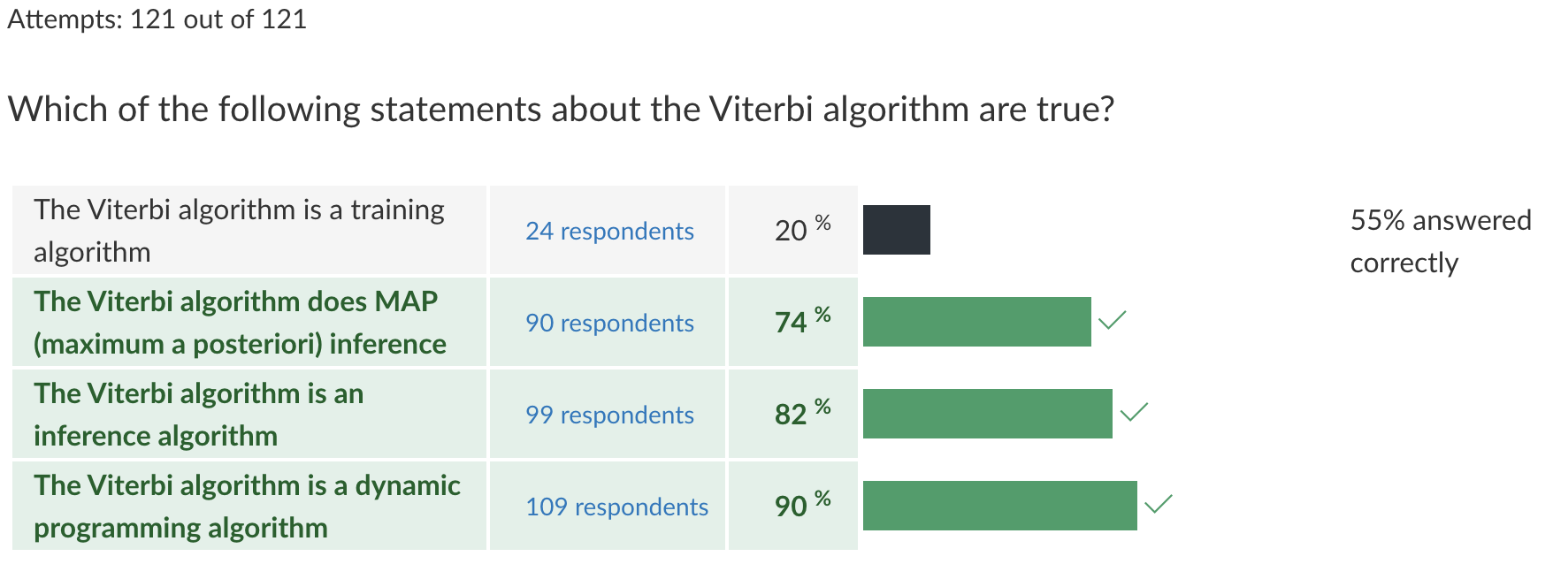
Quiz 6

Slide 4
Constituent View of Syntax
Words group into higher-order linguistic units
Disadvantages:
Doesn't model languages with discontinuous information
In pure CFG form, lexically grounded selection preference is lost
May be too much information for downstream applications
birds (?)
Example from Noah Smith
Notes:
Examples for discontinuous info:
Due to the weather, we are sure that they left.
After school, Connor has been practicing piano.

Slide 5
Lexicalization
propagate heads
But, this leads to sparsity --> Requires lots of smoothing
Maybe it's too much information?
Can we ignore the categories and just focus on the relationship of the words to each other?

Slide 6
equivalent, but shows word order
(head -> modifier)
remove phrase labels
throw away node and merge children if parent has the propagated label
annotation can be in-line

Slide 8
Dependency View of Syntax
No explicit phrase structure
Key feature: how do words relate to each other?
Advantages:
Closer alignment between analyses of different languages
Natural modeling of relationships between discontinuous words
Lexically grounded relationships
Disadvantages:
Some loss of expressivity
Requires explicit notion of head
Another formalism: what are the annotation standards, how to build corpora, etc.?
Notes:
Derived from different linguistic theories.
----------------------------------------------------------
Free word order: S → VP NP; S → NP VP
The d-trees are more similar among languages than the c-trees
Similar to the 1st point
Directly apply on words
---------------------------------------------------------
D-trees are simplified representations, there can be two different c-trees corresponds to the same d-trees, but c-trees to d-trees are pretty convertible.
Easier to learn and tends to capture most of the information that needed for downstream applications.

Slide 9
Edge Labels
It can be useful to distinguish different kinds of head-modifier relations, by labeling edges
Important relations for English:
subject
direct object
determiner
adjective modifier
……
Different treebanks use different sets
Example from Noah Smith
Notes:
Pobj: object of a preposition

Slide 10
Applications
For information extraction tasks involving real-world relationships between entities, chains of dependencies provide good features
Notes:
Shortest dependency path feature.

Slide 11
Where do Edge Labels Come From?
Dependency Treebanks
Prague Dependency Treebank: 1.5 million words of direct annotation (in Czech)
Universal Dependencies (universaldependencies.org): many languages, various sizes: 1k words of Sanskrit, 10k words Kurmanji, 400k words English, 123k words Chinese, etc.
Conversion approaches
rules for converting combination of constituency labels, heads, and other factors into dependency labels (deMarneffe, 2006)

Slide 12
Content vs Functional Heads
The head was the "important" word in a phrase
NP(the crystal clear ball)
VP(kill the enemy)
Notes:
Unambiguous cases

Slide 13
Content vs Functional Heads
But...
PP(into the woods) or PP(into the woods)?
VP(was always watching tv) or VP(was always watching tv)?
This is characterized as having a functional head or content head
Choice depends on goals; for universal dependencies, trend is toward content
Notes:
Ambiguous cases

Slide 14
Head Choice
What to do about this?
??
we wash cats and dogs

Slide 15
Head Choice
What to do about this?
we wash cats and dogs
first conjunct is the head of the NP

Slide 16
Head Choice
What to do about this?
we wash cats and dogs
coordinating conjunction is the head of the NP

Slide 17
Head Choice
What to do about this?
Pick a standard and stick with it
we wash cats and dogs
second conjunct is the head of the NP

Slide 18
Projectivity
A sentence's dependency parse is said to be projective if every subtree (node and all its descendants) occupies a contiguous span of the sentence
This also means the dependency parse can be drawn on top of the sentence without any crossing edges

Slide 19
Nonprojectivity
Other sentences are nonprojective
Nonprojectivity is rare in English, but quite common in many languages
Note: in the above example, reordering the clauses would result in projectivity without changing the meaning

Slide 20
Parsing Approaches
constituency and project
pretty good for English, not as much for others
doesn't handle non-projective
graph based (Chiu-Liu Edmonds)
see reading: http://ufal.mff.cuni.cz/~bejcek/parseme/prague/Nivre2.pdf
can handle non-projective
quadratic time
transition based
linear time
approximate solution
doesn't handle non-projective
Notes:
Directed minimum spanning tree

Slide 21
Shift-Reduce Parsing
Big Idea: keep a stack of words and do work at the top of the stack
Fundamental operations:
SHIFT: add a word to the stack
REDUCE-LEFT: link top 2 stack members, pop one member, and create a dependency
REDUCE-RIGHT: link top 2 stack members, pop one member, and create a dependency
Difference between REDUCE operations is which direction the dependency goes and which member gets popped
(Note: In Jurafsky/Manning chapter, these are called "LEFT-ARC" and "RIGHT-ARC")

Slide 22
Shift
Very simple: just move one word over!
STACK
SYMBOLS
dogs
gently
blue
walk
[root]

Slide 23
Reduce Left
Top of the stack is head, next on the stack is dependent.
Pop both, form relationship, push back head
STACK
SYMBOLS
gently
dogs
blue
walk
[root]

Slide 24
Reduce Left
Top of the stack is head, next on the stack is dependent.
Pop both, form relationship, push back head
STACK
SYMBOLS
gently
dogs
walk
blue
[root]

Slide 25
Reduce Right
Top of the stack is dependent, next on the stack is head.
Pop both, form relationship, push back head
STACK
SYMBOLS
gently
dogs
blue
walk
[root]

Slide 26
Reduce Right
Top of the stack is dependent, next on the stack is head.
Pop both, form relationship, push back head
STACK
SYMBOLS
gently
[root]
dogs
blue
walk

Slide 27
WALKTHROUGH
book
the
flight
through
houston
stack | symbols | action | relation
[root] | book the flight through houston | S
[root] book | the flight through houston | S
[root] book the | flight through houston | S
[root] book the flight | through houston | L | the <- flight
[root] book flight | through houston | S
[root] book flight through | houston | S
[root] book flight through houston |  | L | through <- houston
[root] book flight houston |  | R | flight -> houston
[root] book flight |  | R | book -> flight
[root] book |  | R | [root] -> book
[root] |  | Done
First, can we draw the tree ourselves using intuition?
Agree on an interpretation
Agree on a head standard
Start off with a stack seeded with the root
Actions are Reduce Left (RL), Reduce Right (RR), Shift
(If arcs are labeled, each reduce would also have a label)
Nothing to reduce at the beginning, so Shift

Slide 28
WALKTHROUGH
book
the
flight
through
houston
stack | symbols | action | relation
[root] | book the flight through houston | S
[root] book | the flight through houston | S
[root] book the | flight through houston | S
[root] book the flight | through houston | L | the <- flight
[root] book flight | through houston | S
[root] book flight through | houston | S
[root] book flight through houston |  | L | through <- houston
[root] book flight houston |  | R | flight -> houston
[root] book flight |  | R | book -> flight
[root] book |  | R | [root] -> book
[root] |  | Done
Now, we can choose RR, RL, Shift, based on P(RR | ...) vs P(RL | ...) vs P(S | ...)
... = ??
What has been built?
What is in the stack (nothing other than those tokens)?
What is left in the symbol queue (most of the sentence)?
Note that 'book' probably should be the main verb in the sentence
But we want to build its children before we build it
So, a well-trained parser should "Shift" here

Slide 29
WALKTHROUGH
book
the
flight
through
houston
stack | symbols | action | relation
[root] | book the flight through houston | S
[root] book | the flight through houston | S
[root] book the | flight through houston | S
[root] book the flight | through houston | L | the <- flight
[root] book flight | through houston | S
[root] book flight through | houston | S
[root] book flight through houston |  | L | through <- houston
[root] book flight houston |  | R | flight -> houston
[root] book flight |  | R | book -> flight
[root] book |  | R | [root] -> book
[root] |  | Done
Again we can choose RR, RL, Shift,
"the" is the head of "book"? (RL)
No, that would be really weird...
"book" is the head of "the"? (RR)
That would make sense in the noun phrase "the book" but not here
Again, a well-trained parser should "Shift" here

Slide 30
WALKTHROUGH
book
the
flight
through
houston
stack | symbols | action | relation
[root] | book the flight through houston | S
[root] book | the flight through houston | S
[root] book the | flight through houston | S
[root] book the flight | through houston | L | the <- flight
[root] book flight | through houston | S
[root] book flight through | houston | S
[root] book flight through houston |  | L | through <- houston
[root] book flight houston |  | R | flight -> houston
[root] book flight |  | R | book -> flight
[root] book |  | R | [root] -> book
[root] |  | Done
Now consider
"flight" is the head of "the"? (RL)
Seems like a likely pairing. If we ran a POS tagger we would ask "noun head of a det?" and be confident. Order is good.
Which word should be put back to the stack?

Slide 31
WALKTHROUGH
book
the
flight
through
houston
stack | symbols | action | relation
[root] | book the flight through houston | S
[root] book | the flight through houston | S
[root] book the | flight through houston | S
[root] book the flight | through houston | RL | the <- flight
[root] book flight | through houston | S
[root] book flight through | houston | S
[root] book flight through houston |  | L | through <- houston
[root] book flight houston |  | R | flight -> houston
[root] book flight |  | R | book -> flight
[root] book |  | R | [root] -> book
[root] |  | Done
"flight" is the head of "book"? (RL)
If it's two nouns, that might make sense (noun compound). We may note that there's no other likely verb in the sentence though, so hopefully this wouldn't happen. But it's a place we could go wrong!
"book" is the head of "flight"? (RR)
If "book" is a verb (yes here), this seems likely. However, in this case we need to build the subtree for flight (the "flight through houston"). So hopefully we can encourage the parser to defer this decision. But it’s another place we could go wrong!
should we shift? (S)
This is a ambiguous case, but it is the "correct" action to take (hopefully a well-trained parser will learn)

Slide 32
WALKTHROUGH
book
the
flight
through
houston
stack | symbols | action | relation
[root] | book the flight through houston | S
[root] book | the flight through houston | S
[root] book the | flight through houston | S
[root] book the flight | through houston | RL | the <- flight
[root] book flight | through houston | S
[root] book flight through | houston | S
[root] book flight through houston |  | L | through <- houston
[root] book flight houston |  | R | flight -> houston
[root] book flight |  | R | book -> flight
[root] book |  | R | [root] -> book
[root] |  | Done
"through" is the head of "flight"? (RL)
Unlikely
"flight" is the head of "through"? (RR)
In a prepositional phrase, but then "through" would come first
should we shift? (S)
Yes

Slide 33
WALKTHROUGH
book
the
flight
through
houston
stack | symbols | action | relation
[root] | book the flight through houston | S
[root] book | the flight through houston | S
[root] book the | flight through houston | S
[root] book the flight | through houston | RL | the <- flight
[root] book flight | through houston | S
[root] book flight through | houston | S
[root] book flight through houston |  | L | through <- houston
[root] book flight houston |  | R | flight -> houston
[root] book flight |  | R | book -> flight
[root] book |  | R | [root] -> book
[root] |  | Done
"houston" is the head of "through"? (RL)
Yes, in a prepositional phrase, with content heads
"through" is the head of "houston"? (RR)
No, because we're content-head not function-head
should we shift? (S)
No more symbols so this should have a probability of 0

Slide 34
WALKTHROUGH
book
the
flight
through
houston
"houston" is the head of "flight"? (RL)
No, "flight" is more important to the sentence. When joining a noun phrase and prep phrase, the noun phrase should dominate
"flight" is the head of "houston"? (RR)
Yes, for the reasons above
No more symbols so shift
stack | symbols | action | relation
[root] | book the flight through houston | S
[root] book | the flight through houston | S
[root] book the | flight through houston | S
[root] book the flight | through houston | L | the <- flight
[root] book flight | through houston | S
[root] book flight through | houston | S
[root] book flight through houston |  | RL | through <- houston
[root] book flight houston |  | R | flight -> houston
[root] book flight |  | R | book -> flight
[root] book |  | R | [root] -> book
[root] |  | Done

Slide 35
WALKTHROUGH
book
the
flight
through
houston
"flight" is the head of "book"? (RL)
If it was a noun compound, maybe, but there is a det (“the”) in between. So highly unlikely.
"book" is the head of "flight"? (RR)
Yes. Note that we were presented with this option before and shifted
stack | symbols | action | relation
[root] | book the flight through houston | S
[root] book | the flight through houston | S
[root] book the | flight through houston | S
[root] book the flight | through houston | L | the <- flight
[root] book flight | through houston | S
[root] book flight through | houston | S
[root] book flight through houston |  | RL | through <- houston
[root] book flight houston |  | RR | flight -> houston
[root] book flight |  | R | book -> flight
[root] book |  | R | [root] -> book
[root] |  | Done

Slide 36
WALKTHROUGH
book
the
flight
through
houston
stack | symbols | action | relation
[root] | book the flight through houston | S
[root] book | the flight through houston | S
[root] book the | flight through houston | S
[root] book the flight | through houston | RL | the <- flight
[root] book flight | through houston | S
[root] book flight through | houston | S
[root] book flight through houston |  | RL | through <- houston
[root] book flight houston |  | RR | flight -> houston
[root] book flight |  | RR | book -> flight
[root] book |  | R | [root] -> book
[root] |  | Done
"book" is the head of [root]? (RL)
No, [root] should never be a dependent
[root] is the head of "book"? (RR)
Yes, and there's nothing left to add to "book"

Slide 37
WALKTHROUGH
book
the
flight
through
houston
stack | symbols | action | relation
[root] | book the flight through houston | S
[root] book | the flight through houston | S
[root] book the | flight through houston | S
[root] book the flight | through houston | RL | the <- flight
[root] book flight | through houston | S
[root] book flight through | houston | S
[root] book flight through houston |  | RL | through <- houston
[root] book flight houston |  | RR | flight -> houston
[root] book flight |  | RR | book -> flight
[root] book |  | RR | [root] -> book
[root] |  | Done

Slide 38
How to Determine a Step Sequence Given a Tree (for training)?
Much less uncertainty than the parsing walkthrough. There is a deterministic algorithm:
If you can Reduce Left (i.e. if the result is legitimate), do it, otherwise,
If you can Reduce Right and all dependents of the top have been added, do it, otherwise,
Shift
We can use these oracle rules and a corpus of trees to build a corpus of labeled sequences

Slide 39
Generating a step sequence
RL
RR (and all deps of the top token are satisfied)
Shift
book
the
flight
through
houston
stack | symbols | action | relation
[root] | book the flight through houston | S
[root] book | the flight through houston | S
[root] book the | flight through houston | S
[root] book the flight | through houston | L | the <- flight
[root] book flight | through houston | S
[root] book flight through | houston | S
[root] book flight through houston |  | L | through <- houston
[root] book flight houston |  | R | flight -> houston
[root] book flight |  | R | book -> flight
[root] book |  | R | [root] -> book
[root] |  | Done
Nothing to reduce left
Nothing to reduce right
Shift!

Slide 40
Generating a step sequence
RL
RR (and all deps of the top token are satisfied)
Shift
book
the
flight
through
houston
stack | symbols | action | relation
[root] | book the flight through houston | S
[root] book | the flight through houston | S
[root] book the | flight through houston | S
[root] book the flight | through houston | L | the <- flight
[root] book flight | through houston | S
[root] book flight through | houston | S
[root] book flight through houston |  | L | through <- houston
[root] book flight houston |  | R | flight -> houston
[root] book flight |  | R | book -> flight
[root] book |  | R | [root] -> book
[root] |  | Done
"book" is not the head of [root]
[root] is the head of "book" but "book" has unsatisfied dependencies
Shift!

Slide 41
Generating a step sequence
RL
RR (and all deps of the top token are satisfied)
Shift
book
the
flight
through
houston
stack | symbols | action | relation
[root] | book the flight through houston | S
[root] book | the flight through houston | S
[root] book the | flight through houston | S
[root] book the flight | through houston | L | the <- flight
[root] book flight | through houston | S
[root] book flight through | houston | S
[root] book flight through houston |  | L | through <- houston
[root] book flight houston |  | R | flight -> houston
[root] book flight |  | R | book -> flight
[root] book |  | R | [root] -> book
[root] |  | Done
"the" is not the head of "book"
"book" is not head of "the"
Shift!

Slide 42
Generating a step sequence
RL
RR (and all deps of the top token are satisfied)
Shift
book
the
flight
through
houston
stack | symbols | action | relation
[root] | book the flight through houston | S
[root] book | the flight through houston | S
[root] book the | flight through houston | S
[root] book the flight | through houston | L | the <- flight
[root] book flight | through houston | S
[root] book flight through | houston | S
[root] book flight through houston |  | L | through <- houston
[root] book flight houston |  | R | flight -> houston
[root] book flight |  | R | book -> flight
[root] book |  | R | [root] -> book
[root] |  | Done
"flight" is head of "the". RL!

Slide 43
Generating a step sequence
RL
RR (and all deps of the top token are satisfied)
Shift
book
the
flight
through
houston
stack | symbols | action | relation
[root] | book the flight through houston | S
[root] book | the flight through houston | S
[root] book the | flight through houston | S
[root] book the flight | through houston | RL | the <- flight
[root] book flight | through houston | S
[root] book flight through | houston | S
[root] book flight through houston |  | L | through <- houston
[root] book flight houston |  | R | flight -> houston
[root] book flight |  | R | book -> flight
[root] book |  | R | [root] -> book
[root] |  | Done
"flight" is not head of "book"
"book" is head of "flight" but "flight" has unsatisfied dependents
Shift!

Slide 44
Generating a step sequence
RL
RR (and all deps of the top token are satisfied)
Shift
book
the
flight
through
houston
stack | symbols | action | relation
[root] | book the flight through houston | S
[root] book | the flight through houston | S
[root] book the | flight through houston | S
[root] book the flight | through houston | RL | the <- flight
[root] book flight | through houston | S
[root] book flight through | houston | S
[root] book flight through houston |  | L | through <- houston
[root] book flight houston |  | R | flight -> houston
[root] book flight |  | R | book -> flight
[root] book |  | R | [root] -> book
[root] |  | Done
"through" is not head of "flight"
"flight" is not head of "through"
Shift!

Slide 45
Generating a step sequence
RL
RR (and all deps of the top token are satisfied)
Shift
book
the
flight
through
houston
stack | symbols | action | relation
[root] | book the flight through houston | S
[root] book | the flight through houston | S
[root] book the | flight through houston | S
[root] book the flight | through houston | RL | the <- flight
[root] book flight | through houston | S
[root] book flight through | houston | S
[root] book flight through houston |  | L | through <- houston
[root] book flight houston |  | R | flight -> houston
[root] book flight |  | R | book -> flight
[root] book |  | R | [root] -> book
[root] |  | Done
"houston" is head of "through". LR!

Slide 46
Generating a step sequence
RL
RR (and all deps of the top token are satisfied)
Shift
book
the
flight
through
houston
stack | symbols | action | relation
[root] | book the flight through houston | S
[root] book | the flight through houston | S
[root] book the | flight through houston | S
[root] book the flight | through houston | RL | the <- flight
[root] book flight | through houston | S
[root] book flight through | houston | S
[root] book flight through houston |  | RL | through <- houston
[root] book flight houston |  | R | flight -> houston
[root] book flight |  | R | book -> flight
[root] book |  | R | [root] -> book
[root] |  | Done
"houston" is not head of "flight"
"flight" is head of "houston" and all other dependencies of "houston" are satisfied. RR!

Slide 47
Generating a step sequence
RL
RR (and all deps of the top token are satisfied)
Shift
book
the
flight
through
houston
stack | symbols | action | relation
[root] | book the flight through houston | S
[root] book | the flight through houston | S
[root] book the | flight through houston | S
[root] book the flight | through houston | RL | the <- flight
[root] book flight | through houston | S
[root] book flight through | houston | S
[root] book flight through houston |  | RL | through <- houston
[root] book flight houston |  | RR | flight -> houston
[root] book flight |  | R | book -> flight
[root] book |  | R | [root] -> book
[root] |  | Done
"flight" is not head of "book"
"book" is head of "flight" and all other dependencies of "flight" are satisfied. RR!

Slide 48
Generating a step sequence
RL
RR (and all deps of the top token are satisfied)
Shift
book
the
flight
through
houston
stack | symbols | action | relation
[root] | book the flight through houston | S
[root] book | the flight through houston | S
[root] book the | flight through houston | S
[root] book the flight | through houston | RL | the <- flight
[root] book flight | through houston | S
[root] book flight through | houston | S
[root] book flight through houston |  | L | through <- houston
[root] book flight houston |  | RR | flight -> houston
[root] book flight |  | RR | book -> flight
[root] book |  | R | [root] -> book
[root] |  | Done
"book" is not head of [root]
[root] is head of "book" and all other dependencies of "book" are satisfied. RR!

Slide 49
Generating a step sequence
RL
RR (and all deps of the top token are satisfied)
Shift
book
the
flight
through
houston
stack | symbols | action | relation
[root] | book the flight through houston | S
[root] book | the flight through houston | S
[root] book the | flight through houston | S
[root] book the flight | through houston | RL | the <- flight
[root] book flight | through houston | S
[root] book flight through | houston | S
[root] book flight through houston |  | RL | through <- houston
[root] book flight houston |  | RR | flight -> houston
[root] book flight |  | RR | book -> flight
[root] book |  | RR | [root] -> book
[root] |  | Done

Slide 50
Training
Given a sentence and its correct tree, there is a deterministic sequence of shift-reduce operations that will produce the tree from the sentence
Thus, given a state in the process of decoding, there is one correct operation
So train a probabilistic models P(action|state)
Action = {RL, RR, S}
State includes words in the stack, words in the buffer, relations that have been built…

Slide 51
Features
These can generally come from anything we can see
What have we seen (the stack)?
What will we see (the buffer)?
What have we done (the already-extracted links)?
Use the most 'actionable' elements
What did we just see (the top of the stack)?
What will we soon see (the next word or two)?
What have we done that is relevant (links to words in the top of the stack)?
Granularity:
word
POS tag
Neural Network-based feature learning

Slide 52
Feature Templates
Pretty good starting set
Refine for your language, use case, etc.
Jurafsky & Martin, 3rd ed.

Slide 53
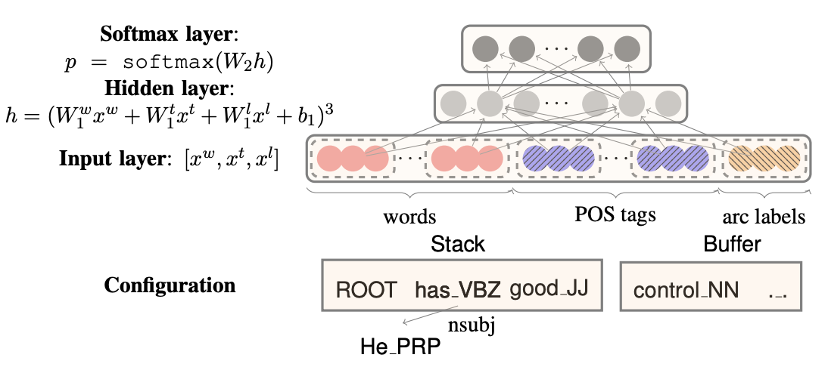
Neural Shift-Reduce Parser

Slide 54
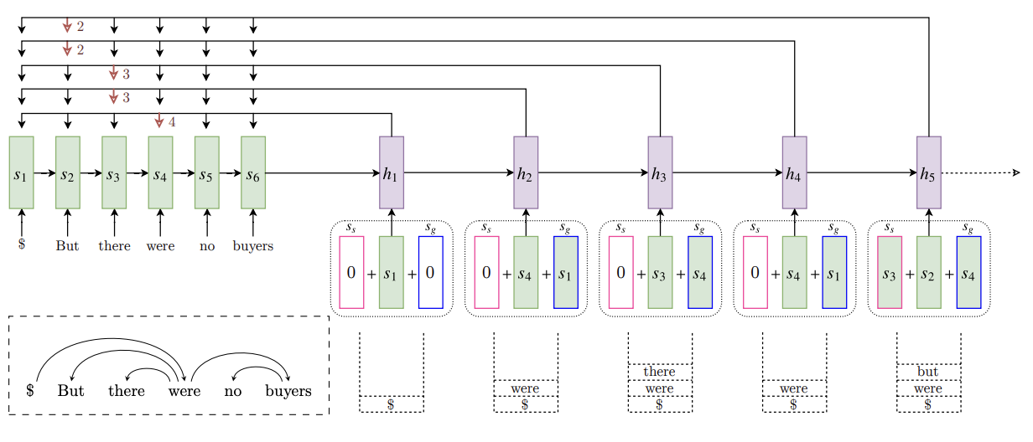
Neural Shift-Reduce Parser
Stack-Pointer Network

Slide 55
Beam Decoding
Shift-Reduce algorithm is greedy; early bad decision can doom later possibilities
Beam search is a general way to be "not as greedy"
Instead of the best step, take k best steps
From each of those k steps, take k best next steps
Keep only the top k of those k² steps
What is the runtime for a sentence of length n and beam of width k?
Beam search is widely used in many other NLP tasks:
MT
ASR
Summarization
Other generation...

Slide 56
Beaming
=0.9
S/0.2
Stack | [root] book the
Symbols | flight through houston
Cost | 0.7
=20.4
R/19.7
S/0.4
Configuration
L/0.7
=1.4
Stack | [root] book
Symbols | the flight through houston
Cost | 0.3
[root]
S/0.14
=17.64
Stack | book
Symbols | the flight through houston
Cost | 17.5
L/17.2
R/19.7
=37.2
L/72.8
=90.3
Beam size: 2
Action (tag) space: 3
R/35.2
book
Stack | [root]
Symbols | the flight through houston
Cost | 35.5

Slide 57
Issues With "Arc-Standard" Shift-Reduce
stack | symbols | action | relation
[root] | book the flight through houston | S
[root] book | the flight through houston | S
[root] book the | flight through houston | S
[root] book the flight | through houston | L | the <- flight
[root] book flight | through houston | S
[root] book flight through | houston | S
[root] book flight through houston |  | L | through <- houston
[root] book flight houston |  | R | flight -> houston
[root] book flight |  | R | book -> flight
[root] book |  | R | [root] -> book
[root] |  | Done
"book" and "flight" first come together
"book" and "flight" relation is built

Slide 58
"Arc-Eager" Variant of Shift-Reduce
Idea: try to form a relation as early as possible
Arc-Standard: strictly bottom-up
Arc-Eager: combination of bottom-up and top-down
Potential harm: might not end up with a tree

Slide 59
Summary
Dependency parses represent syntax with trees whose edges connect words in the sentence. Edges are often labeled with relations like subject
Head rules govern how dependency trees are formed (whether via annotation or conversion from constituency)
Transition-based parsing algorithms provide good accuracy and speed trade off for projective parsing
Arc-Eager variant often easier to train than Arc-Standard, but both use the same infrastructure.
Notes:
Projective: no crossing arcs

